Slide 1

Increasing Box Office Ticket Revenue
Hanna Grossman and Sara Kien

Slide 2
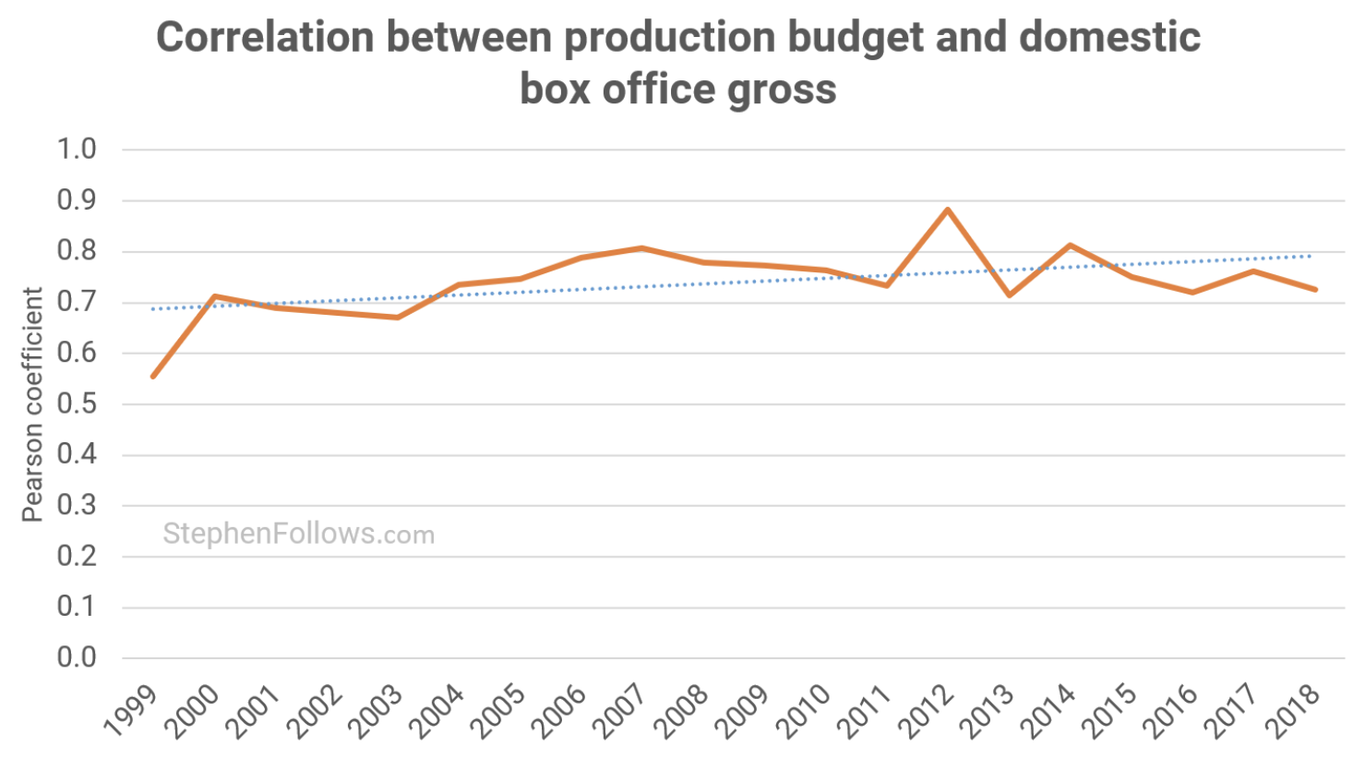
Introduction
Going to a movie is one of the top 10 pastimes
Previous research:
Strong correlations between production budget and revenue
Revenues are especially high for adventure ($65 billion), action ($50 billion), and drama ($36 billion) genres
Very little research has directly compared the effect of budget and genre on movie revenues

Slide 3



Data and Research Design
Research Question
?
Dataset
Is there an effect of production budget and genre on movie revenue?
Box office data released in 2010 collected from TMDB (Kaggle.com) (n=100)
Design
O
T
Models
Explanatory research design to examine the causal effects of budget and genre on revenue
Effect of Production Budget on Revenue
Add Genre as an input variable
Add language as a control variable

Slide 4
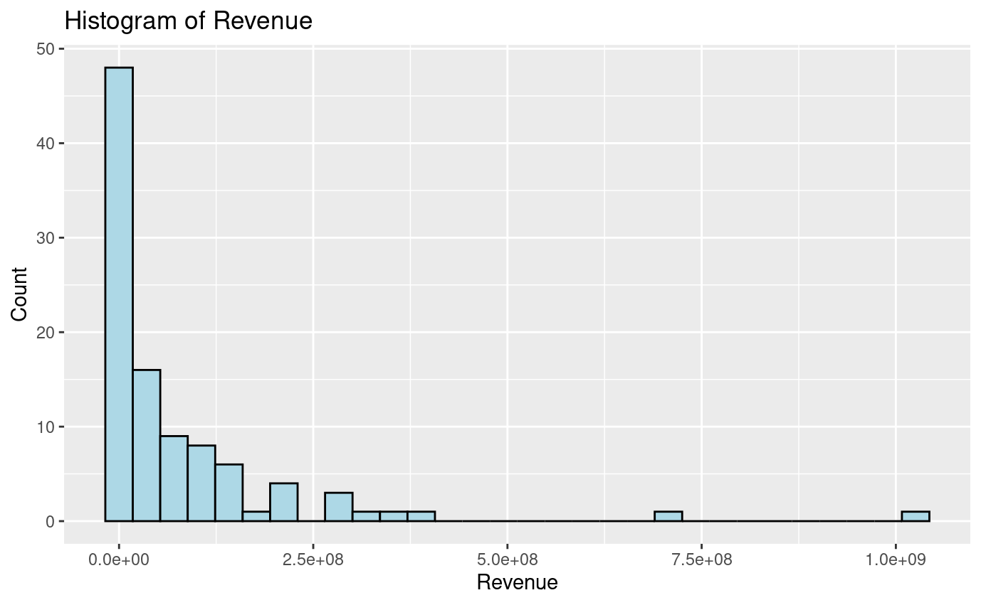
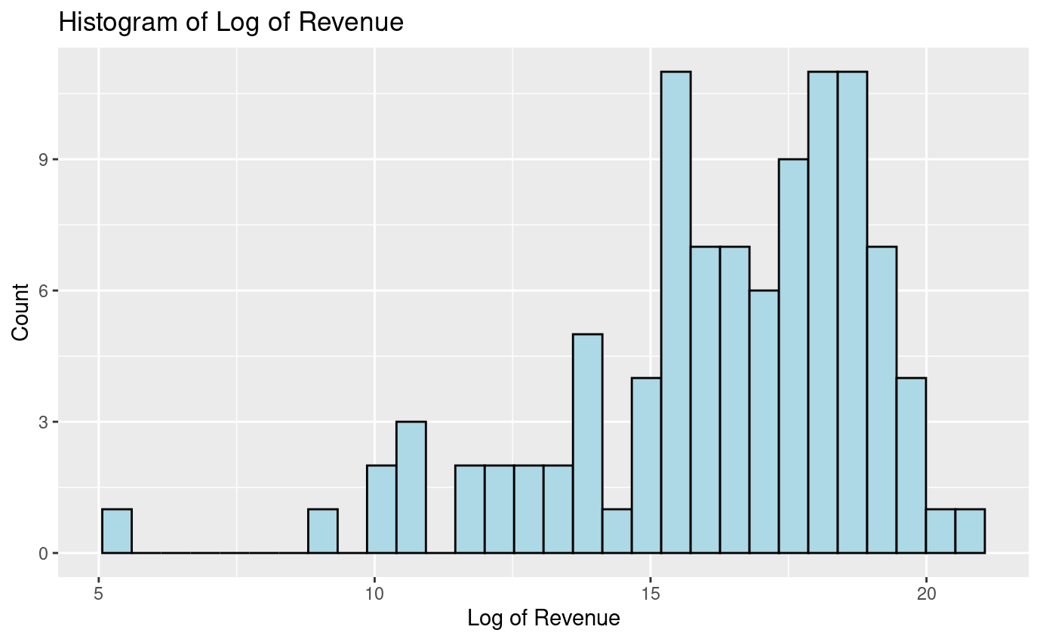
Model Building Process
Exploratory Data Analysis:
Log transformed revenue
Kept budget as is
Formatted action, adventure, drama, and original language variables as true/false

Slide 5
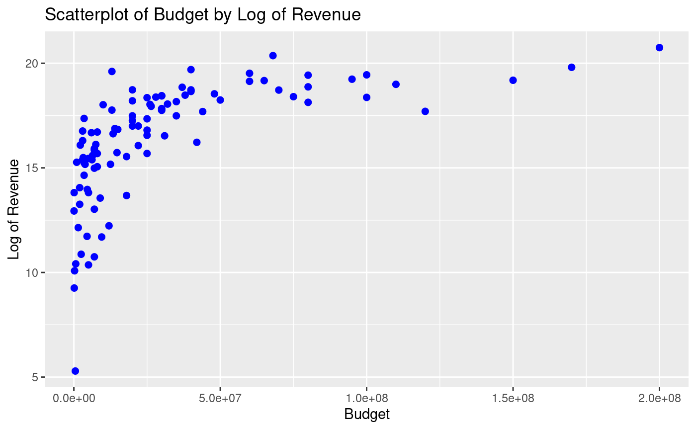
Model Building Process (cont.)
Model 1
log(revenue) = β0 + β1 budget
Model 2
log(revenue) = β0 + β1 budget + β2 action + β3 adventure + β4 drama
Model 3
log(revenue) = β0 + β1 budget + β2 action + β3 adventure + β4 drama + β5 original language english

Slide 6




Results
Std Errs
F-Tests
Results
Significance
Used robust standard errors
Fail to reject null hypothesis and conclude that model 1 is the most appropriate
Revenue will increase by about 0.000004% for every one-unit increase in budget
Statistically
significant, but
not practically
significant

Slide 7
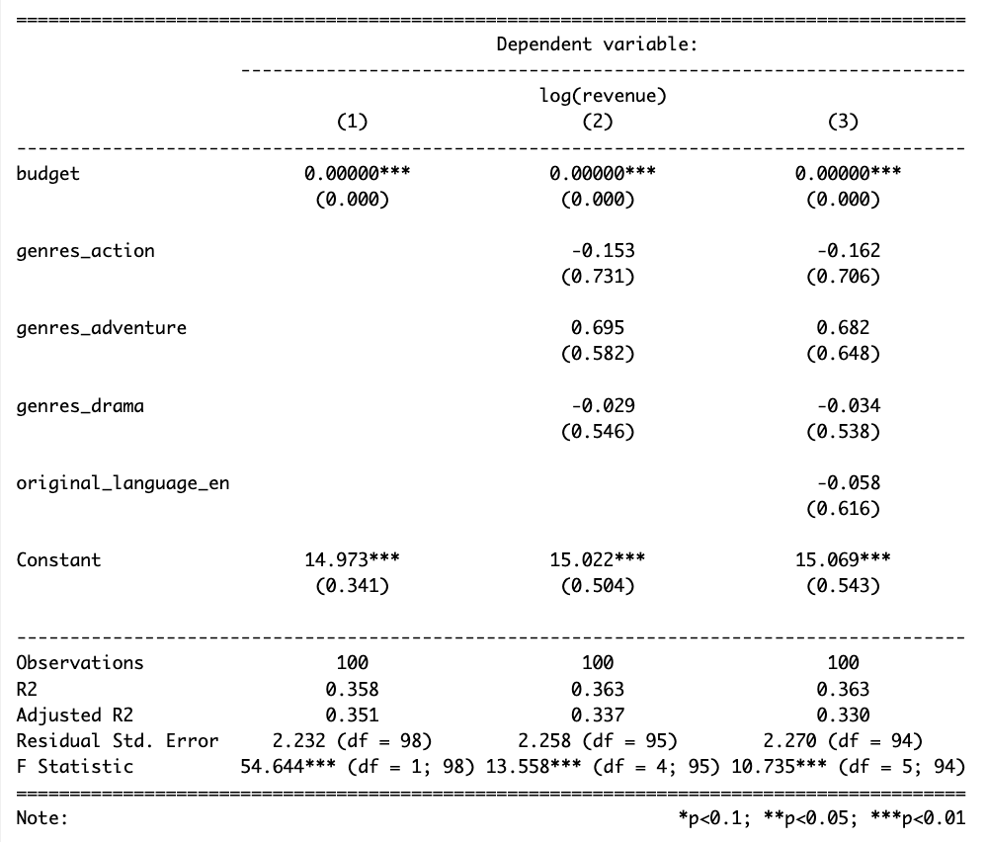
Results (cont.)

Slide 8
Statistical Limitations
Violating Independence:
Our data is likely not independent:
Clustering by company
Clustering by country
Violating Independence:
May produce incorrect standard errors
To combat this, we used robust standard errors
Could also focus in on one country and one production company in the future

Slide 9
Structural Limitations
Omitted Variables:
Marketing via Social Media
Number of Theaters
Streaming
The number of Twitter posts creating buzz about a movie predicts revenue
Number of theaters in which a movie is showing predicts revenue during opening week
An increase in streaming movies at home
All three omitted variables can lead to overestimating the effect of budget on revenue if excluded from the model

Slide 10

Conclusion
The results partially support predictions
The effect of budget is significant across all three models
The effect of genre is not significant
The overall impact of genre may be negligible with respect to profits
Recommendations:
The Data Science team at Acme Movies Inc concludes that budget alone is insufficient to increase profitability of the company.
Additional research needed to examine the potential influence of omitted variables and other features on revenue that the company can manipulate to increase profits.

Slide 11
References
https://www.kaggle.com/competitions/tmdb-box-office-prediction/data?select=train.csv
https://www.the-numbers.com/market/
https://www.thetoptens.com/top-10-pastimes/
https://www.nyfa.edu/student-resources/the-evolution-of-film-over-time-a-brief-history/
https://stephenfollows.com/how-has-the-cost-of-making-a-movie-changed-over-the-past-twenty-years/
https://www.statista.com/statistics/188658/movie-genres-in-north-america-by-box-office-revenue-since-1995/
https://www.screendaily.com/box-office/box-office-analysis-foreign-language-films-in-the-us/5096804.article
https://arxiv.org/pdf/1003.5699.pdf
https://deadline.com/2022/03/streaming-services-mpa-1234977814/
https://thenounproject.com/
https://www.presentermedia.com/powerpoint-clipart/classic-movie-theater-marquee-pc-pid-1639

